Slide 1
Tesla Pump
Virtual Design Review 1
Patrick Duggan, Eric Goff, Garrett Hart, Tom Kline, Chris Salim
Fall 2017
10/19/2017
Team 12

Slide 2
Team Members
Patrick Duggan
Chris Salim
Team Leader
Design Coordinator
Eric Goff
Tom Kline
Secretary
Lead ME
Garrett Hart
Treasurer

Slide 3
Project Brief
Develop Tesla pump for using with in tank propellant mixing and transfer to:
Distribute heat
Transfer fluid in/out of a vessel
Distribute fluid to point of use in vessel
Use of stacked flat disks simplifying:
Layout
Manufacturing process
Pump driven by electric motor

Slide 4
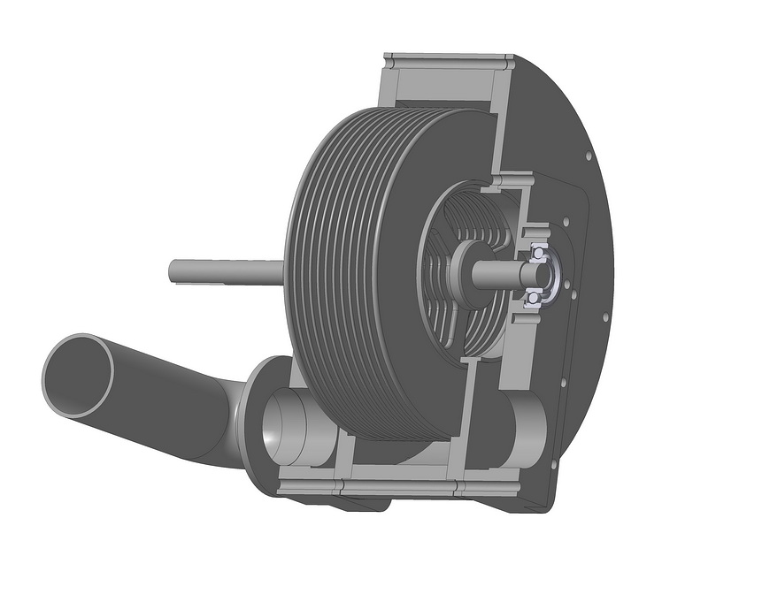
Background Information
Tesla Turbine
Invented and patented by Nikola Tesla in 1913
Bladeless turbine
Series of smooth disks with nozzles spraying fluid
Incoming fluid flows parallel to disks, exhaust moves out sides
Has not been successfully commercialized
Figure 1: Basic layout of Tesla Turbine/Pump.^{[1]}

Slide 5
Background Information
Tesla Pump
Tesla turbine with reverse functions, effectively a pump
Fluid flows in perpendicular to discs, exhaust exits parallel
Commercially available since 1982
Used to pump rougher, more abrasive fluids than a typical pump
Figure 1: Basic layout of Tesla Turbine/Pump.^{[1]}

Slide 6
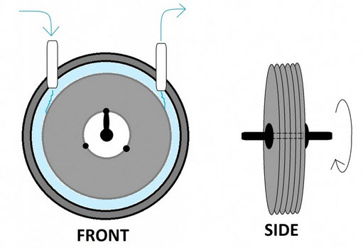
What is a Tesla Pump
The Tesla Pump is a collection of stacked disks
It operates at high RPM
It will be enclosed in housing
The disks have a small specified gap in between each disk
Outlet
Stacked Disks
Inlet
Housing
Figure 2: Depiction of inside a Tesla pump.^{[2]}

Slide 7
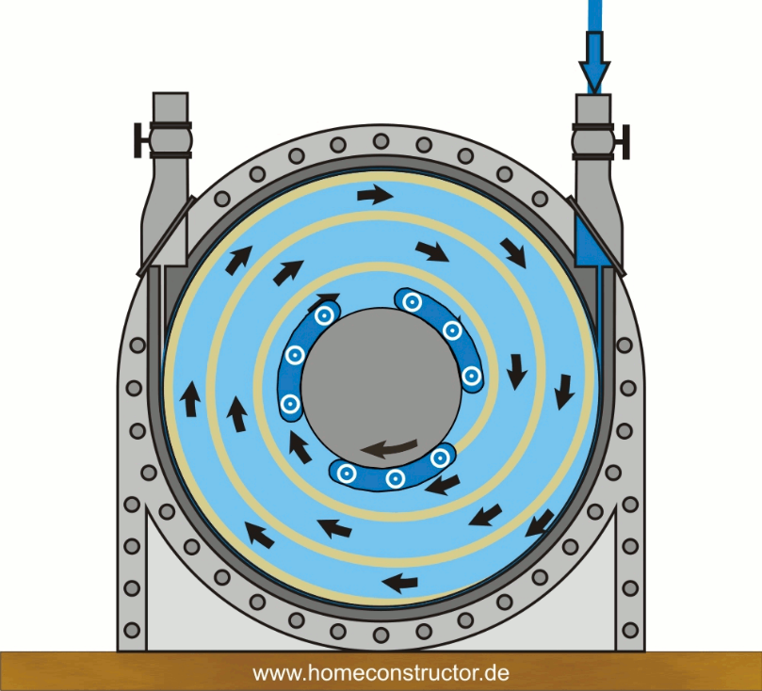
How the Tesla Pump Works
Generate fluid flow by spinning the disks
Thin viscous region created between the disks
Due to friction between the disks and fluid
Region is directly related to the boundary layer effect
As revolutions per minute increase, centripetal force expels the fluid through the outlet
Closed Outlet
Outlet
Force Vector
Inlet
Figure 3: Tesla pump fluid flow visual.^{[3]}

Slide 8
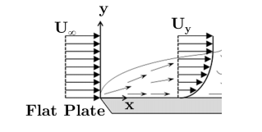
The Boundary Layer Effect
As fluid moves next to surface, velocities of each will theoretically move at the same speed where fluid meets the surface
The boundary layer effect is directly related to:
Fluid viscosity
Surface material
With very small gaps between plates in the pump, this effect will be very prevalent
Free Stream Velocity Profile
Velocity Profile
Boundary Layer
Figure 4: Boundary layer illustration with velocity profiles over a flat plate.^{[4]}

Slide 9
Stakeholders
Sponsor:
NASA – Marshall Space Flight Center (MSFC)
Engineering Liaison:
James Martin
Sponsor:
FAMU – FSU College of Engineering
Engineering Liaison:
James Smith
Project Advisor: Lance Cooley, Ph.D.
Department Advisor: Shayne McConomy, Ph.D.
Department Advisor: Chiang Shih, Ph.D.

Slide 10
Project Scope
Key Goals
Minimize number of parts
Achieve a minimum 5 psi pressure rise
Achieve 15 gpm flow rate
Consume least possible amount of power
Operate at relatively low rpm
Limit weight
Operable in a flange
Meet size constraints
Design and build testable Tesla pump prototype

Slide 11
Project Scope Continued
Primary Markets:
NASA - MSFC
Other government or private aerospace organizations
Secondary Markets:
Other government or private industries related to fluid dynamics
Biomedical industry
Project Assumptions:
Water is a good fluid choice for operational simulation
Materials will be liquid nitrogen compatible
Corrosion and other degradation factors can be mostly ignored
Vary only disk spacing and not disk size

Slide 12
Customer Needs
Our team conducted a conference call to gather information on requirements for the design. What we learned includes:
Fluids being pumped
Prototype will pump water but model the pump to allow for liquid nitrogen as well
Preferred RPM
Pump efficiency is main priority
Size Constraints
Design attaches to an 8 inch 304L SS Conflat flange
Strive to fit through a 4 inch diameter hole
Weight Constraints
No set constraint, but excessively heavy parts should be reassessed
Budget
Estimated no more than $500

Slide 13
Functional Decomposition
Table 1: Functional decomposition category and tasks.

Slide 14
Functional Decomposition
Figure 5: Inside housing functional decomposition. ^{[3]}

Slide 15
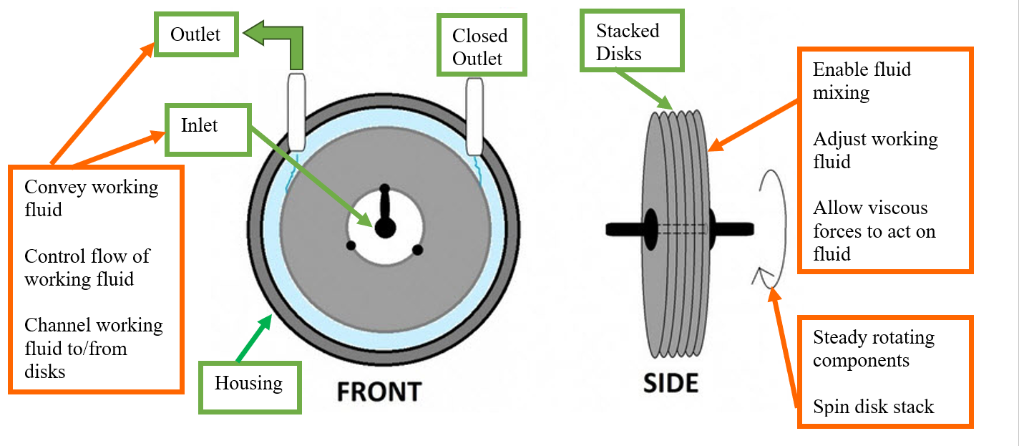
Functional Decomposition
Figure 6: Housing and disks functional decomposition. ^{[2]}

Slide 16
References
[1] “Дисковый насос Тесла.” http://www.teslatech.com.ua.
[2] “Tesla Turbine.” TurbineGenerator, TurbineGernerator, 20 Dec. 2016, turbinegenerator.org/tesla-turbine/.
[3] “Designing a 3D Printed Tesla Turbine.” InterPro, InterPro, 2017, interpromodels.com/designing-a-3d-printed-tesla-turbine/.
[4]Guha, Dr. Tufan K. “Pipe Flow: Major and Minor Losses.” Thermal Fluids Lab Class. Thermal Fluids Lab Class, Tallahassee Fl, FAMU-FSU College of Engineering.

